Slide 1

Development of Comprehensive E-Commerce Website for the XYZ Medical Company
Sprint 1 Overview | Group – 1
By :
Harmanpreet Singh Bedi(30410228), Sahejdeep Singh(30418751),
Devansh Mahajan(30423978), Aakash(30397890)

Slide 2
INTRODUCTION
Overview of the Project
Introduction to Team
Sprint 1 Product Backlog
Critical Reflection
Deliverables of the Project

Slide 3
OVERVIEW OF THE PROJECT
Overview of the project will cover : Vision, Client details, and description of the stakeholders.
Vision : The "Development of a Comprehensive E-commerce Website for XYZ Medical Company (for the Indian Market)" aims to revolutionize the way medical supplies are purchased and managed online.
Client Details :
Name : XYZ medical company – Abbas Shaik
Domain : Indian Medical Equipment Market
Stakeholders :
Stakeholder | Description
XYZ Medical Company | This is the main stakeholder as they are the client to whom the project will be delivered.
Abbas Shaik (Client Representative) | He is representing the client.
End Users (Customers) | These are the users that will use the website once it is made.
Employees | These are the employees of XYZ Medical Company that will be at ease with the enhanced website.
Admins | The admin will take full control of the website.

Slide 4
INTRODUCTION TO THE TEAM
Following is the Project Team that will be responsible for the designing, development, deployment and optimization of
the website.
All the names along with their responsibilities
are represented in the form of a table for
easy guidance :
Name | Course ID | Roles
Harmanpreet Singh Bedi | 30410228 | Product Manager, Developer
Devansh Mahajan | 30418751 | Product Owner
Sahejdeep Singh | 30423978 | Product Owner
Aakash | 30397890 | Developer, Scrum Master
Ways of working :
Establishing a Communication Framework : Daily stand-ups, Sprint Planning, etc. should be facilitated to measure progress.
Collaborative Work and Knowledge Sharing : Online collaborative coding tools should be used in order to work together on complex tasks .
Use of Project Management Tools : Use a tool like Jira, etc. to track tasks, user stories, and sprint progress.
Continuous Feedback and Improvement : Creating and promoting a culture of continuous feedback within the team.

Slide 5
PRODUCT BACKLOG
To create a Product Backlog, we need to define “sprint”.
After creating the sprint, we will create subtasks or “User Stories”.
Each task will be having its own status such as “To Do”, “In Progress” and “Done”.
A task which is yet to be started should be marked by default as “To Do”.
A going on task will be marked “In Progress” by the team member who is assigned that task.
A task once completed will be marked as “Done”.
Following is the backlog decided (prior to sprint):
Requirement gathering and specifications
Prototypes and mock-ups
Front-end Development (html, css)
Back-end Development (database creation and localhost server setup)
Integration of Front-end with Back-end (fully dynamic website)

Slide 6
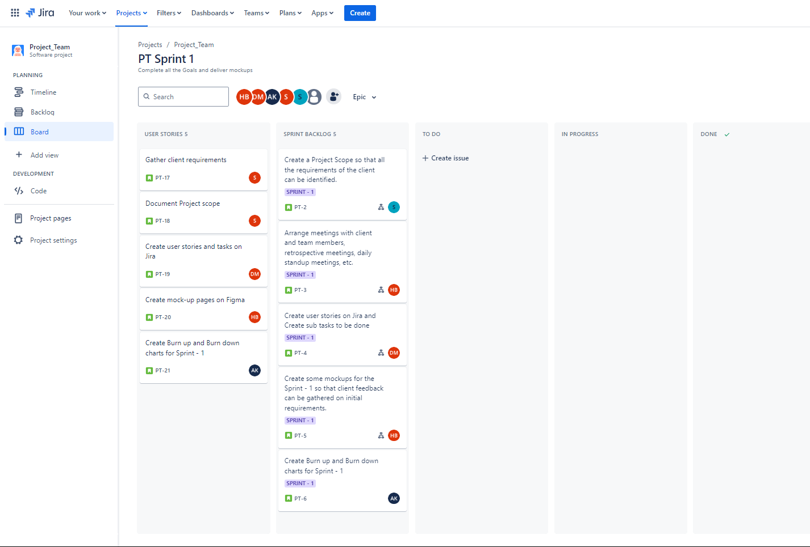
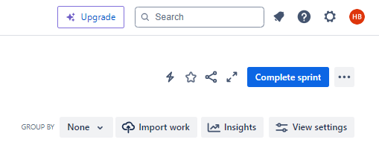
SPRINT BACKLOG
The prioritized sprints will create the Sprint Backlog for sprint 1. Here is the final sprint backlog:
Sprint – 1
Create a Project Scope so that all the requirements of the client can be identified.
Arrange meetings with client and team members, retrospective meetings, daily standup meetings, etc.
Create user stories on Jira and Create sub tasks to be done.
Create some mock-ups for the Sprint - 1 so that client feedback can be gathered on initial requirements.
Create Burn up and Burn down charts for Sprint – 1.

Slide 7
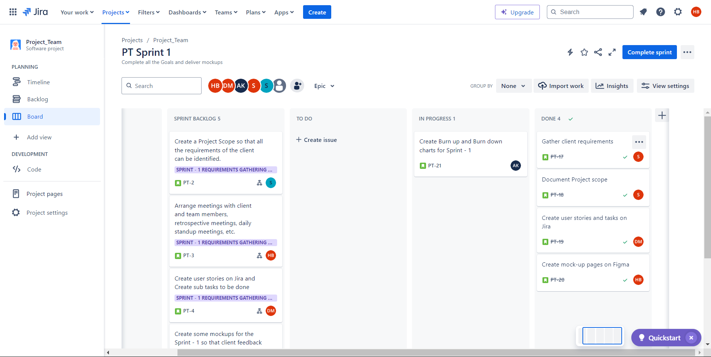
FINAL JIRA BOARD
These show the final Jira board with sprint backlog and completed user stories
Link to our Jira board : https://itech3208.atlassian.net/jira/software/projects/PT/boards/2

Slide 8
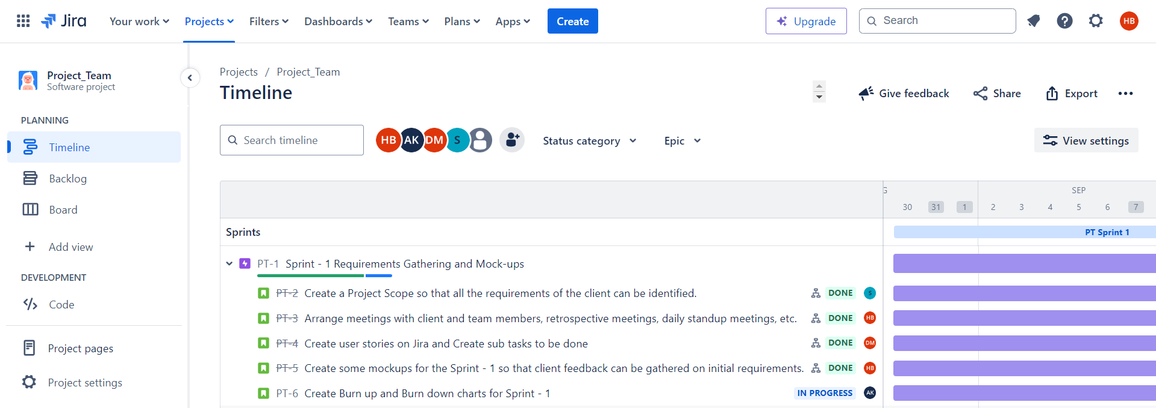
TIMELINE OF USER STORIES
This shows the time taken by each user story to complete.
The duration of the sprint decided was 2 weeks (30th aug – 13th sep)

Slide 9
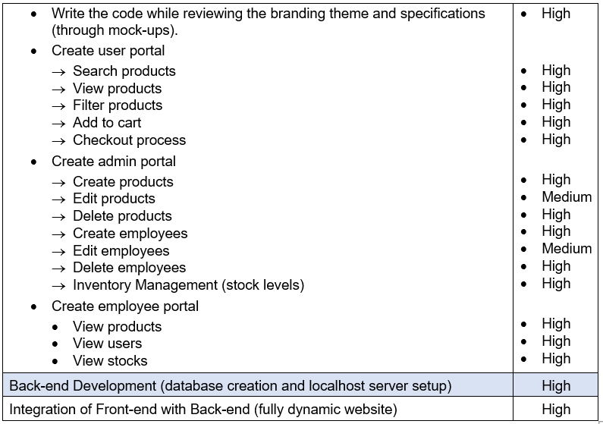
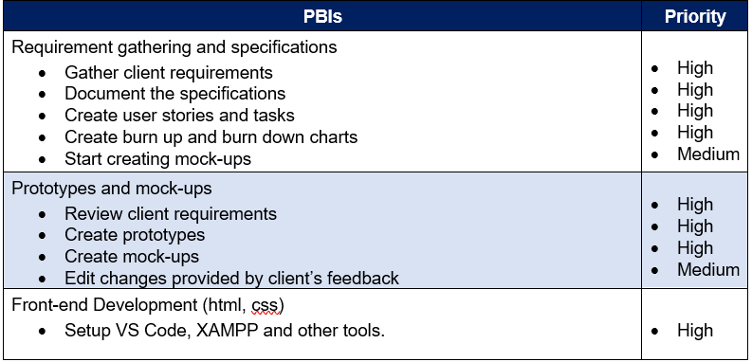
CRITICAL REFLECTION
A backlog refining meeting was conducted and following is the refined product backlog with set priorities :

Slide 10
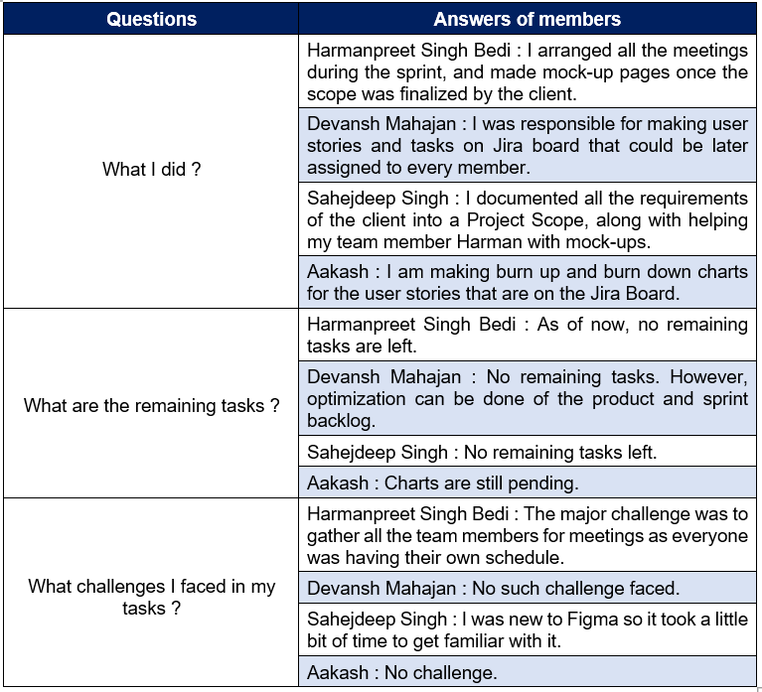
CRITICAL REFLECTION CONTD.
A retrospective meeting at the end of the
sprint was conducted to measure team’s
outcomes and progress made till date.
Following observations were recorded :

Slide 11
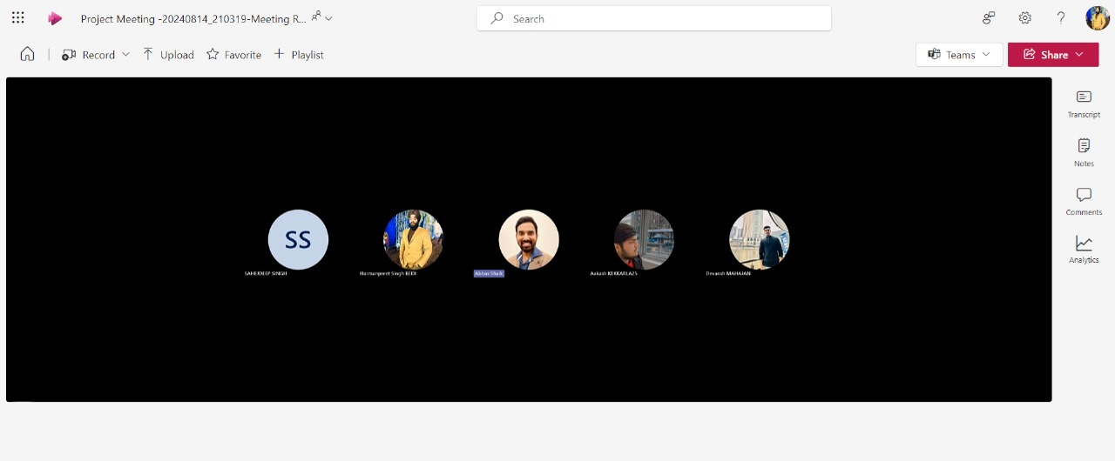
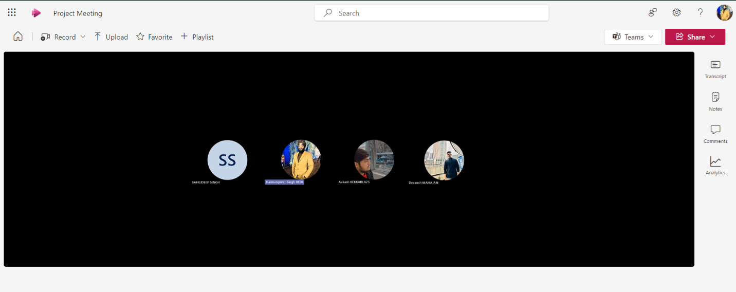
CRITICAL REFLECTION CONTD.
Evidence of all the meetings :
Figure 1. Client feedback meeting
Figure 2. Retrospective meeting
These meetings ensured that the project is on track and the development team is making good progress.
Retrospective meeting ensured that all team members contributed well and there challenges were heard and solved.

Slide 12
DELIVERABLES
Initial requirements of the client :
Aesthetic and responsive design that aligns with the brand identity of XYZ medical company.
Three portals : Admin, Employee and Users
Home page with search functionality and product listing with filters.
Detailed product pages and Chatbot for customer inquiries.
Scope of the Project : The following slide shows the project scope finalized by the client and the team members :

Slide 13
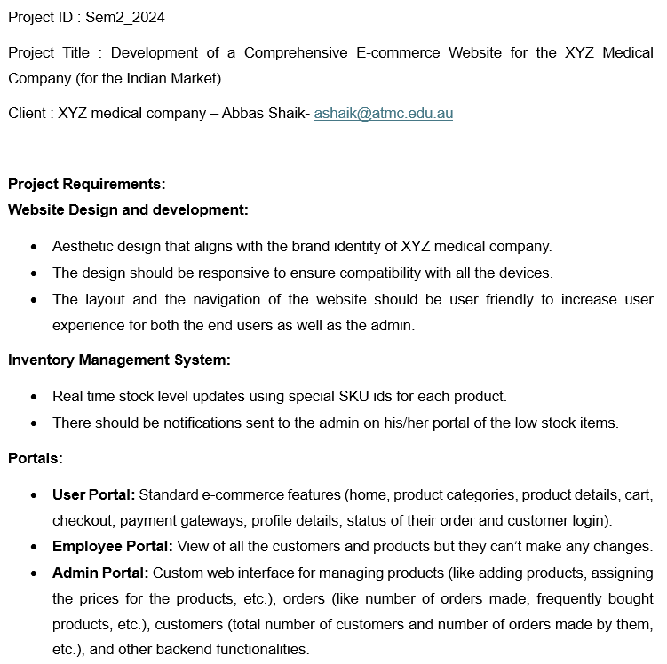
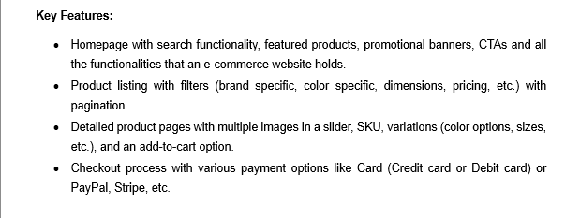
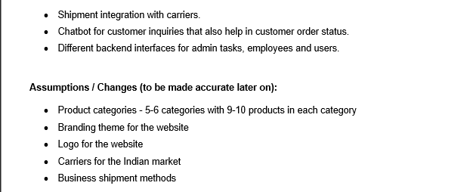
DELIVERABLES (Project Scope)

Slide 14
DELIVERABLES (JIRA user stories)
We created the Sprint Backlog for sprint 1. Here is the final sprint backlog:
Sprint – 1
Create a Project Scope so that all the requirements of the client can be identified.
Arrange meetings with client and team members, retrospective meetings, daily standup meetings, etc.
Create user stories on Jira and Create sub tasks to be done.
Create some mock-ups for the Sprint - 1 so that client feedback can be gathered on initial requirements.
Create Burn up and Burn down charts for Sprint – 1.

Slide 15
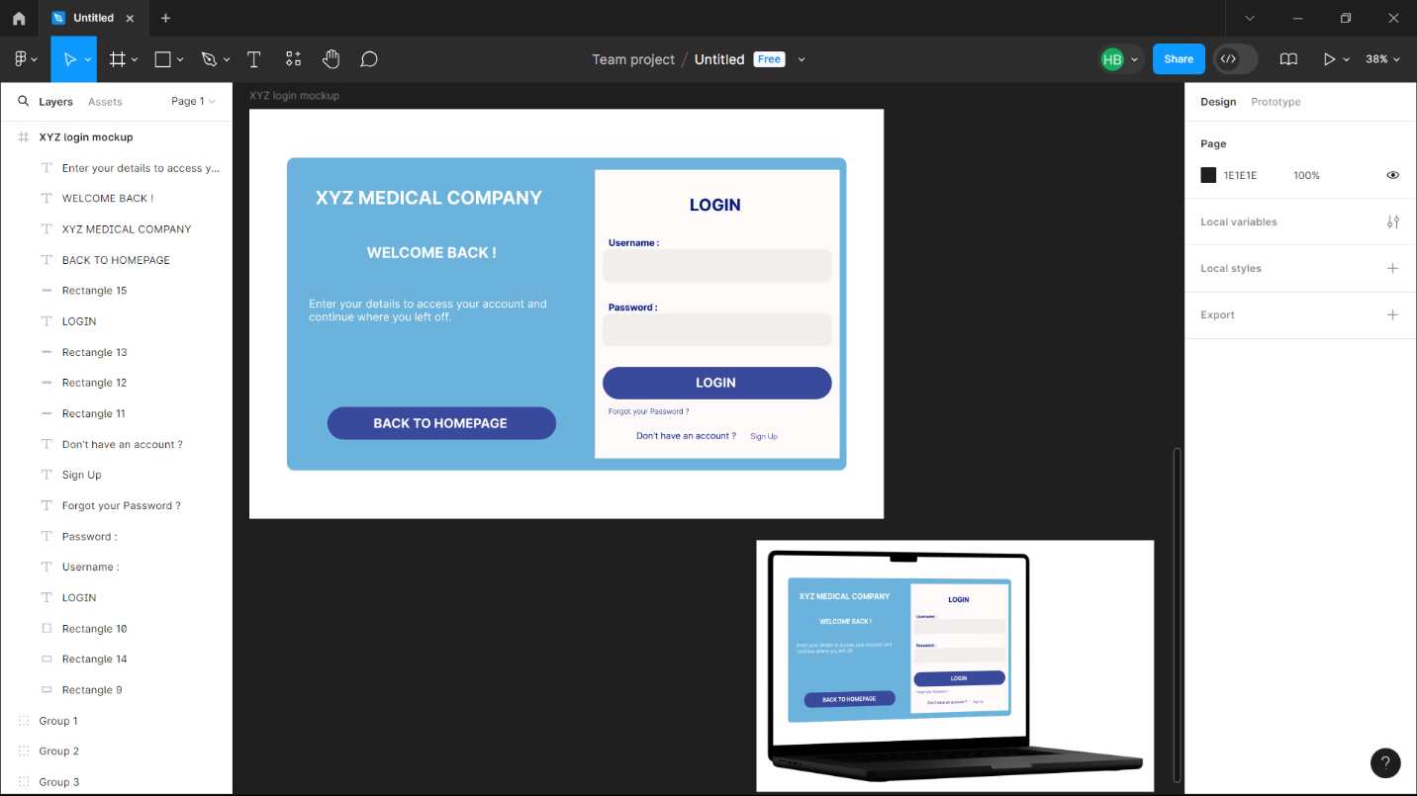
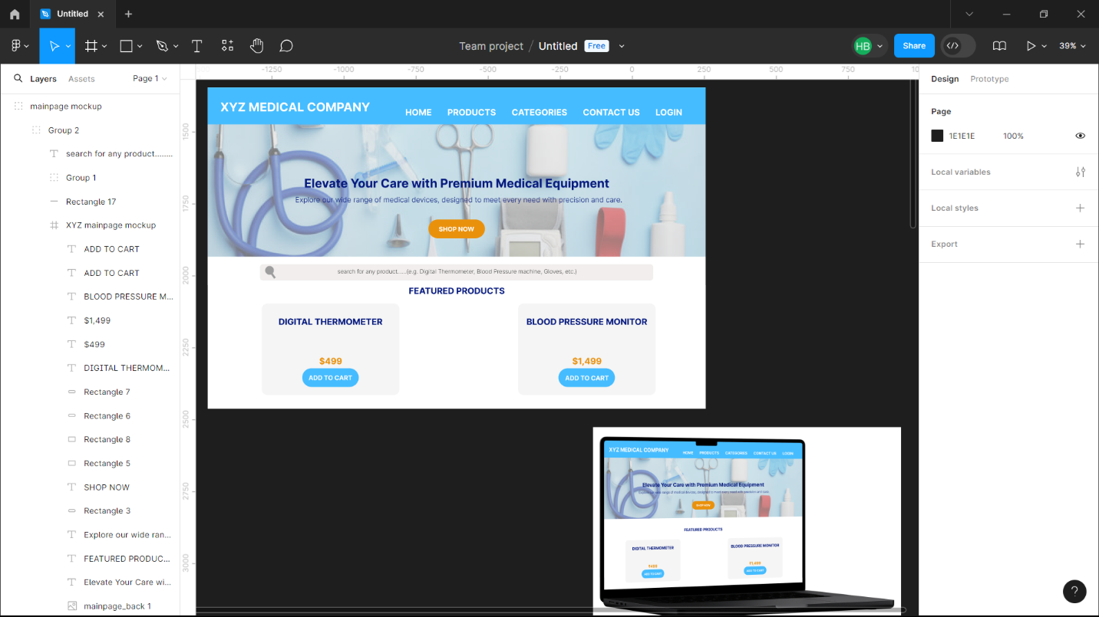
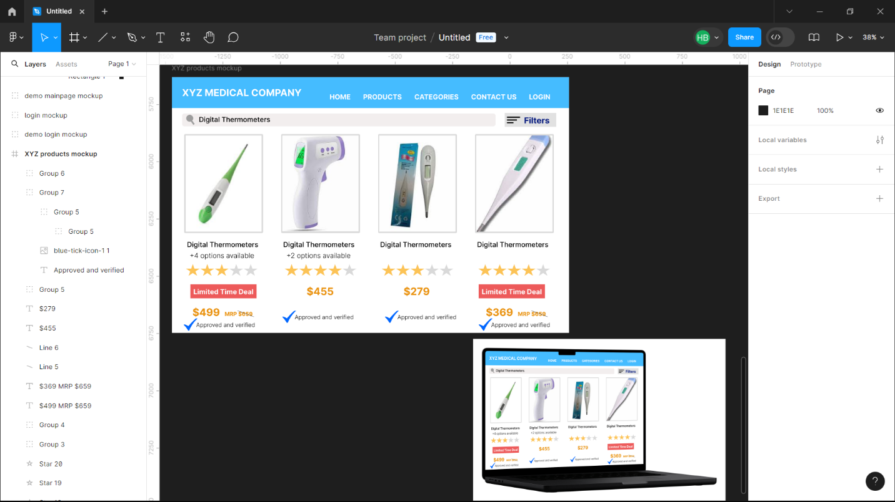
DELIVERABLES (Mock-ups)
Mock-ups were created for Login, Home and Products pages to review the client’s feedback on the project
These mock-ups were created after the scope was finalized.
They match client’s requirements and specifications of the project.
Login mock-up
Home page mock-up
Products mock-up

Slide 16
THANK YOU

